Slide 1

NVIDIA Financial Analysis and Stock Valuation
By Group 5:
Kenechukwu Enem
Gowtham Chandu
LingFang He
Venkata Dhanayya
Sanjana Indu
Date: 14 July 2025

Slide 2
Table of Contents
A. Business Analysis
B. Ratio and Valuation Analysis
Company Overview
Financial Ratios
Current Operations
CAPM & Beta Analysis
Macroeconomic Environment
Free Cash Flow (FCF) Analysis
SWOT Analysis & Industrial Competitors
Stock Valuation via WACC & DCF
Market Share
C. Technical Analysis
D. Recommendations
One-Year Price Chart
Investment Verdict and Conclusion
Monte Carlo Simulation
FB Prophet Forecast
DAB - 401

Slide 3
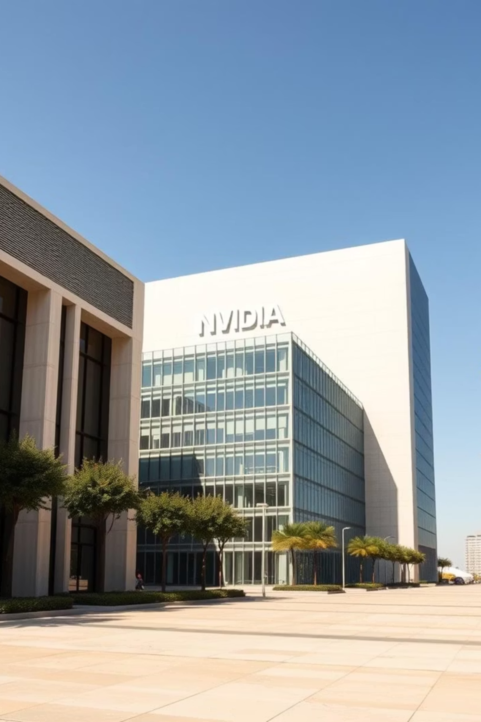
Business Analysis: NVIDIA Corporation
Company Overview & Operations
Founded in 1993, global leader in GPU design.
Expanded from gaming to data centers, AI, and automotive.
Specializes in Graphics cards (GeForce, Quadro) and AI hardware (A100, H100).
DAB - 401

Slide 4

Macroeconomic Environment & Competitors
Growth driven by organic expansion & strategic acquisitions
Thriving due to rising global demand for AI/ML infrastructure.
Benefiting from ongoing digital transformation trends.
Key competitors: AMD, Intel, Qualcomm, Apple.

Slide 5


SWOT Analysis and market share
Strengths: GPU dominance, AI leadership
Weaknesses: High R&D costs, dependence on TSMC
Opportunities: AI, autonomous vehicles, Omniverse
Threats: AMD, Intel, export restrictions.
Holds ~80% market share in discrete GPUs (2024).
Dominates AI and data center GPU sectors.

Slide 6
Ratio and Valuation Analysis: Financial Ratios
NVIDIA demonstrates excellent profitability, strong liquidity, and minimal debt reliance, positioning it as a financially robust company.
48.9%
69.6%
3.53
0.21
Net Profit Margin
Return on Equity (ROE)
Current Ratio
Debt-to-Equity Ratio
67.4%
Sustainable Growth Rate
DAB - 401

Slide 7

Key ratios interpretation
Net Profit Margin (48.9%) - strong pricing power and operational efficiency.
2. Return on Equity (ROE) (69.6%) - highly efficient use of investor capital.
3. Current Ratio (3.53) - Strong liquidity position, indicating NVIDIA can easily meet short-term obligations.
4. Debt-to-Equity Ratio (0.21) - Low financial leverage, suggesting conservative debt usage and lower financial risk.

Slide 8

Ratio and Valuation Analysis: CAPM & Beta
1
2
3
CAPM: Definition & Formula
NVIDIA's Key CAPM Inputs
Cost of Equity & ROE
The Capital Asset Pricing Model (CAPM) estimates a stock's expected return based on its risk. It's vital for company valuation & cost of equity.
Risk-Free Rate: 4.2%
NVIDIA's estimated Cost of Equity: 14.7%.
Market Return: 10.5%
Actual Return on Equity (ROE): 69.6%. This significantly outperforms the required return, showcasing strong profitability and shareholder value.
Beta: 1.68
NVIDIA's Beta (1.68) indicates higher stock volatility, implying greater expected returns and risk vs. market average.
DAB - 401

Slide 9
Ratio and Valuation Analysis: Free Cash Flow & DCF
Robust Free Cash Flow (FCF)
DCF Valuation & WACC
NVIDIA generated a substantial $27.0B in FCF in 2023.
WACC Estimate: ~12.8%
This indicates strong financial health and significant cash generation.
Intrinsic Stock Value (DCF): $109.87
Current Market Price: $120.50
It supports continuous R&D investment and
shareholder returns.
Our DCF model suggests potential overvaluation, as the intrinsic value is below the current market price.
DAB - 401

Slide 10
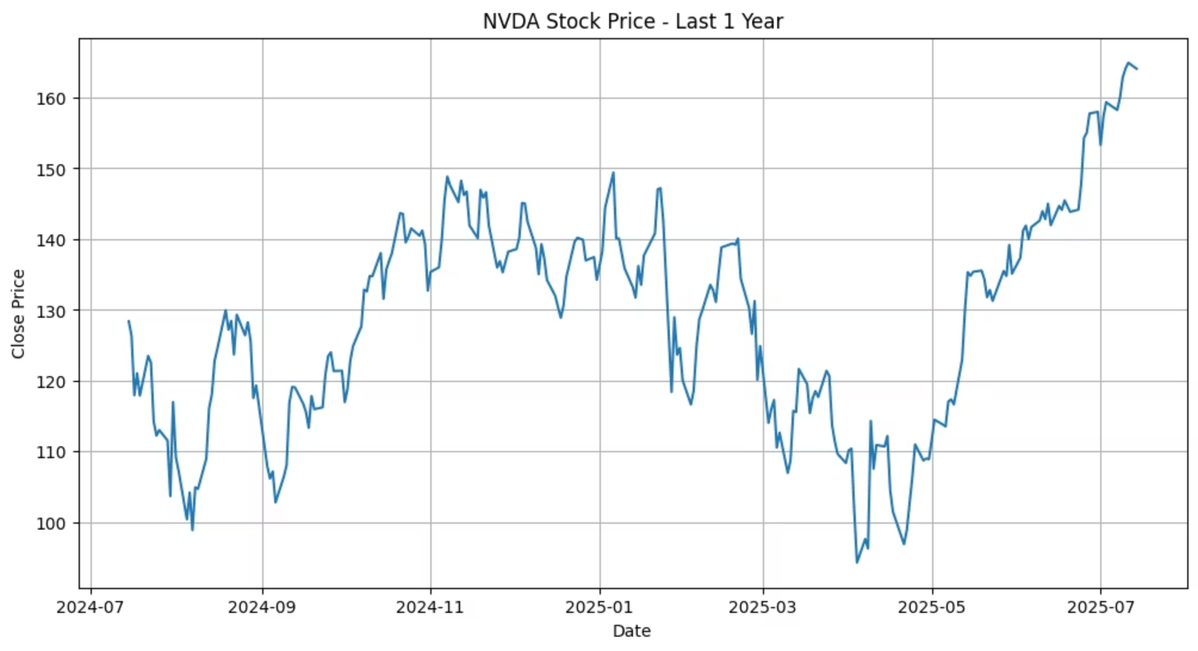
Technical Analysis: One-Year Price Chart
NVIDIA's stock has shown a consistent upward trend over the past year, driven by strong AI momentum and robust earnings growth. Despite fluctuations, the overall trajectory reflects a resilient growth story.
Jul–Oct 2024: Declined to ~$100, indicating volatility.
Nov–Dec 2024: Rebounded strongly to ~$150, fueled by positive earnings and AI growth.
Jan–Mar 2025: Dipped below ~$100, possibly due to broader market pressures.
Apr–Jul 2025: Rallied steadily above ~$160, signaling strong investor confidence.
DAB - 401

Slide 11
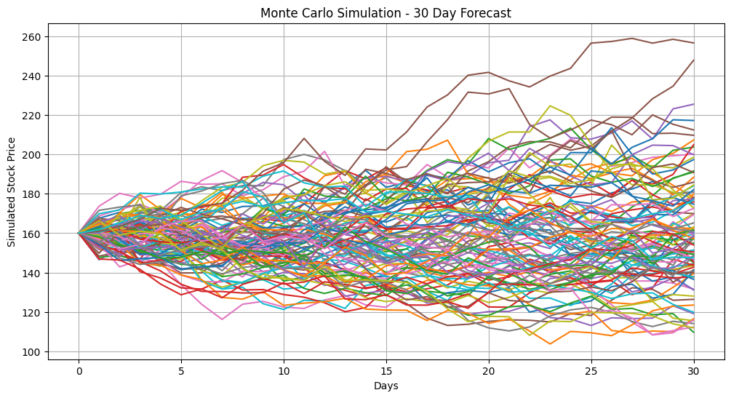
Technical Analysis: Monte Carlo Simulation
Our Monte Carlo Simulation, with 100 iterations over a 30-day horizon, forecasts NVIDIA's stock movement.
~$123.5
$130 – $237
Expected Mean Price
Likely range of price fluctuations.
The simulation suggests moderate volatility and overall bullish momentum, aligning with positive trends observed in the one-year price chart.
DAB - 401

Slide 12
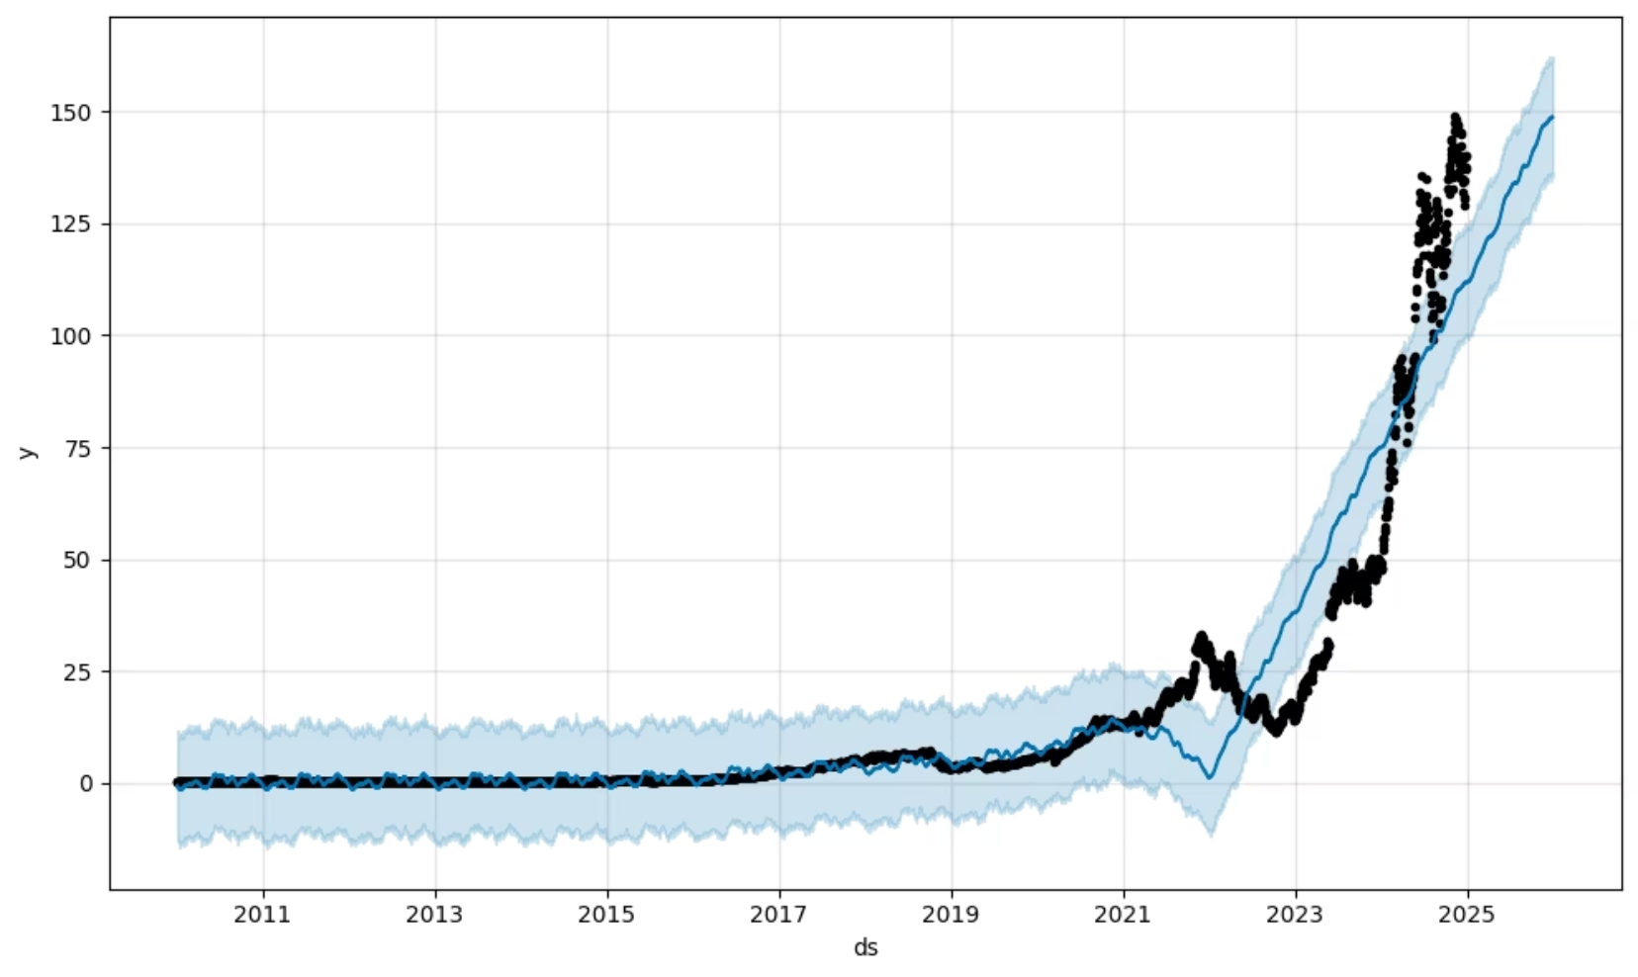
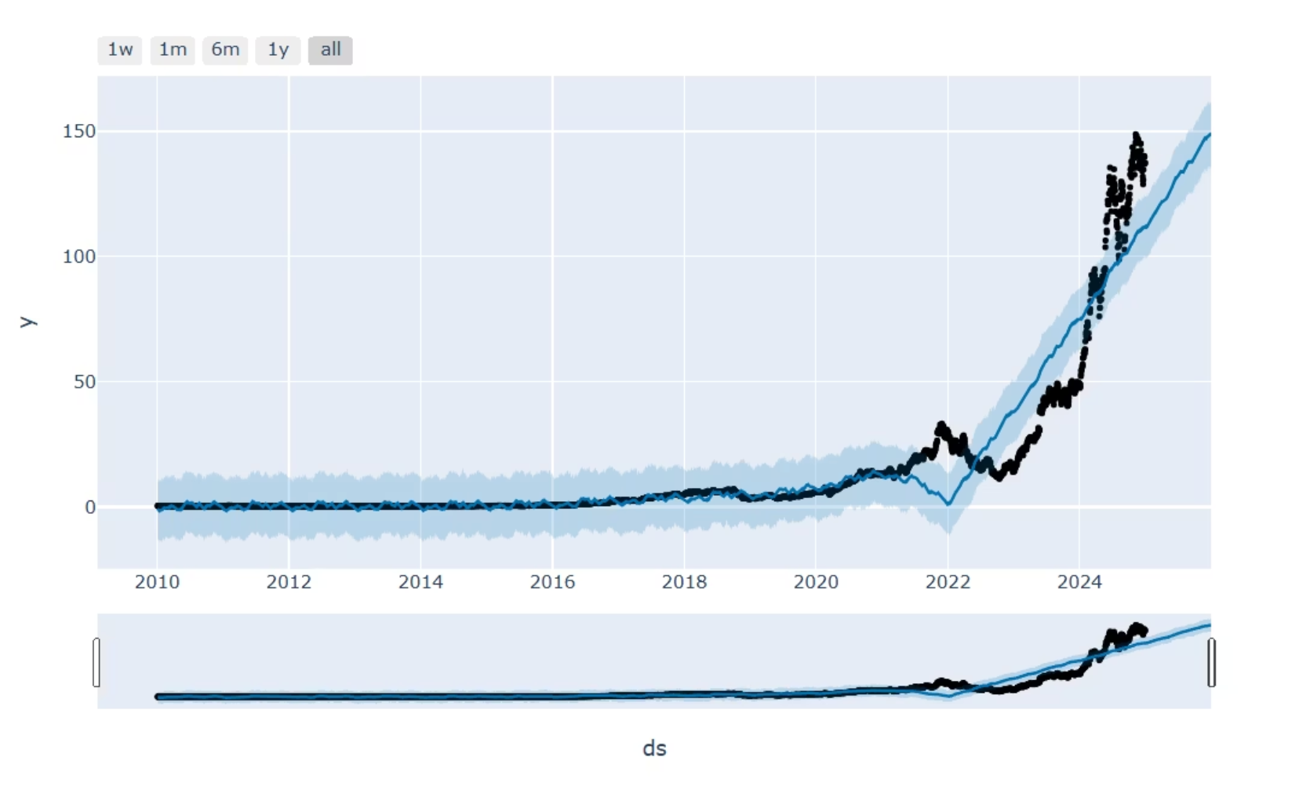
Technical Analysis: FB Prophet Forecast
The FB Prophet model forecasts NVIDIA's stock trajectory, indicating continued upward movement and identifiable seasonality, further strengthening the investment case.
Bullish Outlook
Seasonal Patterns
Stronger Investment
Forecast aligns with Monte Carlo simulation, reinforcing positive near-term price action.
Model identifies valuable seasonal patterns for short-term trading strategies.
Consistent positive trends across analyses strengthen NVIDIA's investment case.
DAB - 401

Slide 13
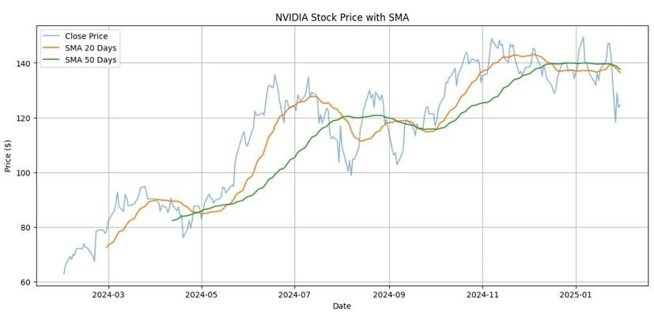
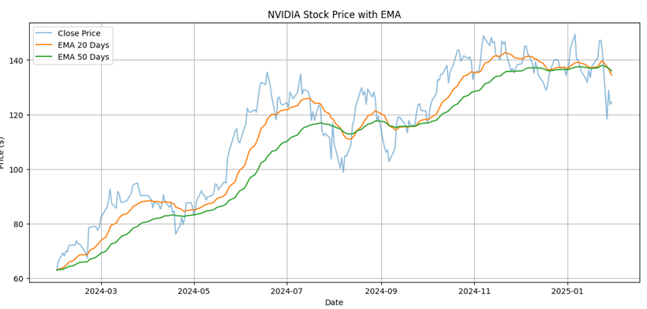
Moving averages – sma, ema
Notes:
We use Simple Moving Averages (SMA) and Exponential Moving Averages (EMA) in technical analysis to:
Smooth out price fluctuations – making it easier to spot trends.
Identify trend direction – upward, downward, or sideways.
Generate trading signals – such as crossovers between short- and long-term averages.
SMA vs. EMA
SMA: Averages prices over a set period equally. It's slower to react to price changes.
EMA: Weighs recent prices more heavily, so it reacts faster to price changes.
Key Observations:
When the 20-day SMA crosses above the 50-day SMA, it often signals a bullish trend (buy signal).
When the 20-day SMA crosses below the 50-day SMA, it may indicate a bearish trend (sell signal).
The SMAs help smooth out the daily price volatility (blue line), making it easier to see the overall direction.

Slide 14

Risks & ESG Factors
Risks:
Export restrictions to China
Competition from AMD, Intel, Apple
Regulatory scrutiny in AI/semis
ESG Positives:
Low power consumption chips
Investments in green computing
Carbon-neutral goal by 2030
Notes:
Core of Technology: CPUs, GPUs, memory chips, and sensors all rely on semiconductors.
Economic Indicator: The semiconductor industry reflects global demand for tech and innovation.
Strategic Importance: Countries view semiconductor manufacturing as critical for national security and economic competitiveness.

Slide 15
Recommendations: Investment Verdict
Investment Verdict: BUY
Strong Financial Performance
Strong BUY recommendation for NVIDIA, signaling confidence in its future performance.
Robust profitability with high Gross (75%) & Net (48.9%) Profit Margins.
Leadership in High-Growth AI Markets
Solid Liquidity and Low Debt
Dominant market share (~80%) in discrete GPUs. Leads rapidly expanding AI/deep learning sectors.
Excellent liquidity (Current Ratio 3.53). Low Debt-to-Equity (0.21) indicates minimal financial risk.
Positive Technical Outlook
Upward trend and bullish momentum confirmed by one-year price chart, Monte Carlo, and FB Prophet forecasts.
DAB - 401

Slide 16



Conclusion
Our comprehensive analysis reaffirms a BUY recommendation for NVIDIA Corporation. It's a compelling investment due to strong financials, unparalleled AI market leadership, and a consistently bullish technical outlook.
Strong Financials
AI Market Dominance
Positive Technical Outlook
Robust profitability, high margins, and exceptional shareholder value.
Leading the rapidly expanding AI and deep learning sectors with cutting-edge solutions.
Consistent upward trends and bullish momentum in technical analyses.
DAB - 401

Slide 17

Thank You!
We welcome your questions!

